Slide 1
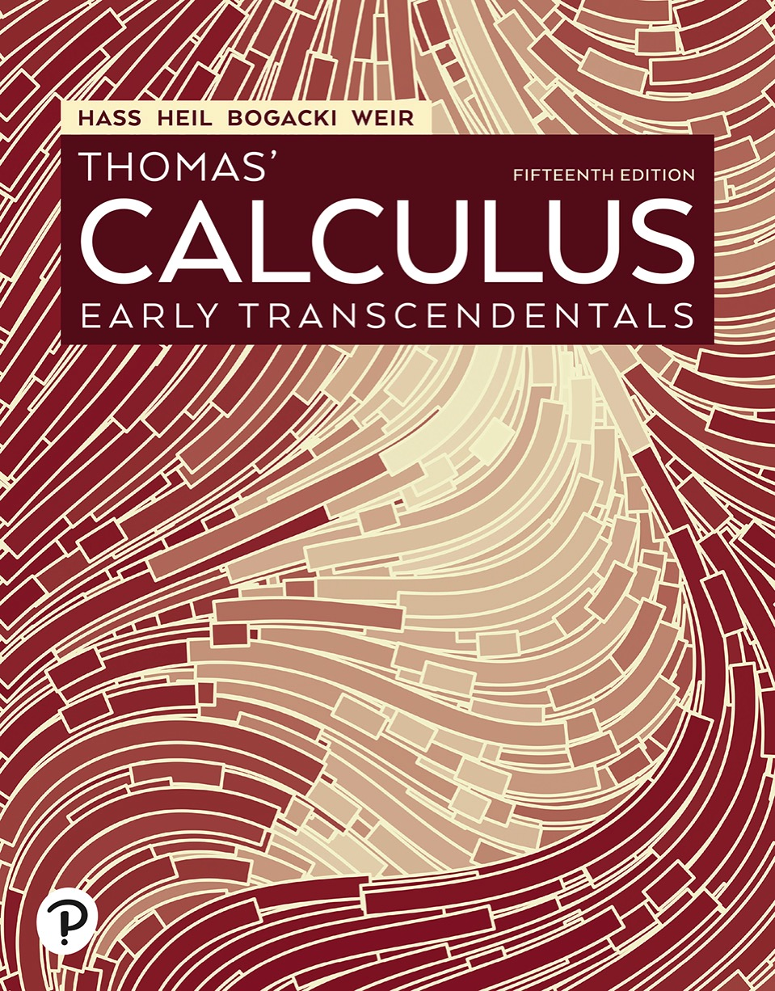

Thomas’ Calculus: Early Transcendentals
Fifteenth Edition
Chapter 14
Partial Derivatives
Copyright © 2023, 2018, 2014 Pearson Education, Inc. All Rights Reserved
Notes:
If this PowerPoint presentation contains mathematical equations, you may need to check that your computer has the following installed:
1) MathType Plugin
2) Math Player (free versions available)
3) NVDA Reader (free versions available)

Slide 2
Section 14.8 Lagrange Multipliers

Slide 3
Constrained Maxima and Minima (1 of 4)
Example: Find the point
on the plane
that is closest to the origin.
Solution: The problem asks us to find the minimum value of the function
subject to the constraint that
Since
has a minimum value wherever the function

Slide 4
Constrained Maxima and Minima (2 of 4)
Solution (continued):
has a minimum value, we may solve the problem by finding
the minimum value of
subject to the constraint
(thus avoiding square roots). If we
regard x and y as the independent variables in this equation and write z as
our problem reduces to one of finding the points (x, y) at which the function

Slide 5
Constrained Maxima and Minima (3 of 4)
Solution (continued):
has its minimum value or values. Since the domain of h is the entire x y-plane, the First Derivative Test tells us that any minima that h might have must occur at points where
This leads to
which has the solution

Slide 6
Constrained Maxima and Minima (4 of 4)
Solution (concluded):
We may apply a geometric argument together with the Second Derivative Test to show that these values minimize h. The z-coordinate of the corresponding point on the plane
is
Therefore, the point we seek is
Closest point:
The distance from P to the origin is

Slide 7
The Method of Lagrange Multipliers (1 of 10)
Theorem—The Orthogonal Gradient Theorem
Suppose that
is differentiable in a region
whose interior contains a smooth curve
If
is a point on C where f has a local maximum or
minimum relative to its values on C, then
is orthogonal to C at

Slide 8
The Method of Lagrange Multipliers (2 of 10)
Corollary: At the points on a smooth curve
where a differentiable function
takes on its local maxima and minima relative to its
values on the curve,

Slide 9
The Method of Lagrange Multipliers (3 of 10)
The Method of Lagrange Multipliers
Suppose that
are differentiable and
when
To find the local maximum
and minimum values of f subject to the constraint
(if these exist), find the values of x, y, z, and
that simultaneously satisfy the equations
For functions of two independent variables, the condition is similar, but without the variable z.

Slide 10
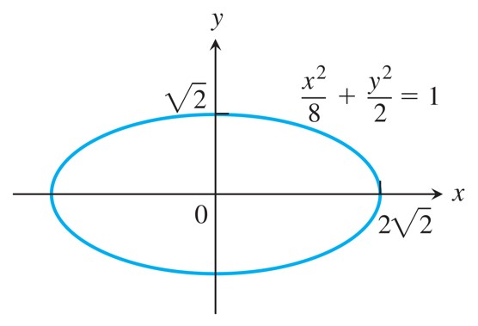
The Method of Lagrange Multipliers (4 of 10)
The Example shows how to find the largest and smallest values of the product x y on this ellipse.

Slide 11
The Method of Lagrange Multipliers (5 of 10)
Example: Find the greatest and smallest values that the function
takes on the ellipse
Solution: We want to find the extreme values of
subject to the constraint

Slide 12
The Method of Lagrange Multipliers (6 of 10)
Solution (continued):
To do so, we first find the values of x, y, and
for which
The gradient equation in the first Equation gives
from which we find

Slide 13
The Method of Lagrange Multipliers (7 of 10)
Solution (continued):
so that y = 0 or
We now consider these
two cases.
Case 1: If y = 0, then x = y = 0. But (0, 0) is not on the
ellipse. Hence,
Case 2: If
then
Substituting this in the equation
gives

Slide 14
The Method of Lagrange Multipliers (8 of 10)
Solution (continued):
The function
therefore takes on its extreme values
on the ellipse at the four points
The extreme
values are x y = 2 and
The Geometry of the Solution The level curves of the function
are the hyperbolas
(See next Figure).
The farther the hyperbolas lie from the origin, the larger the
absolute value of f. We want to find the extreme values of
given that the point (x, y) also lies on the ellipse
Which hyperbolas intersecting the ellipse lie farthest from the origin?

Slide 15
The Method of Lagrange Multipliers (9 of 10)
Solution (concluded):
The hyperbolas that just graze the ellipse, the ones that are tangent to it, are farthest. At these points, any vector normal
to the hyperbola is normal to the ellipse, so
is a multiple
At the point (2, 1), for
example,
At the point

Slide 16
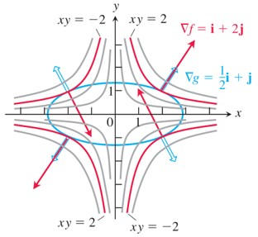
The Method of Lagrange Multipliers (10 of 10)
When subjected to the constraint
the function
takes on extreme values at the four
points
These are the points on the ellipse where
(red) is a scalar multiple of
(blue).
Notes:
The gradient f = i + 2 j and gradient g = 1 half i + j are pointing in the upward direction. The second level curve in the second quadrant is labeled, x y = negative 2. The gradient f and gradient g are pointing downward and upward, respectively. The second level curve in the third quadrant is labeled, x y = 2. The gradient f and gradient g are pointing downward. The second level curve in the fourth quadrant is labeled, x y = negative 2. The gradient f and gradient g are pointing upward and downward, respectively.

Slide 17
Lagrange Multipliers with Two Constraints (1 of 7)

Slide 18
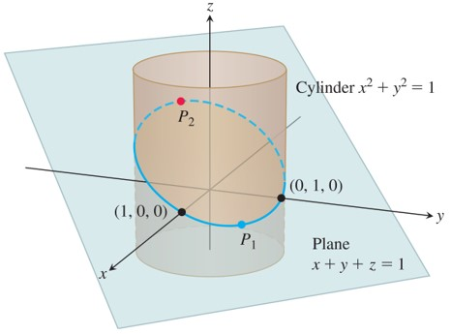
Lagrange Multipliers with Two Constraints (2 of 7)
On the ellipse where the plane and cylinder meet, we find the points closest to and farthest from the origin.
Notes:
A three dimensional plane, x + y + z = 1, intersects the cylinder, forming an ellipse at the point of intersection. The four points marked on the ellipse are (1, 0, 0), P sub 1, (0, 1, 0), and P sub 2.

Slide 19
Lagrange Multipliers with Two Constraints (3 of 7)
Example: The plane
cuts the cylinder
in an ellipse. Find the points on the ellipse that
lie closest to and farthest from the origin.
Solution: We find the extreme values of
(the square of the distance from (x, y, z) to the origin) subject to the constraints

Slide 20
Lagrange Multipliers with Two Constraints (4 of 7)
Solution (continued):
The gradient equation then gives
or
The scalar equations yield

Slide 21
Lagrange Multipliers with Two Constraints (5 of 7)
Solution (continued):
The above Equations are satisfied simultaneously if either
If z = 0, then solving Equations simultaneously to find the corresponding points on the ellipse gives the two points (1, 0, 0) and (0, 1, 0).
If x = y, then the Equations give

Slide 22
Lagrange Multipliers with Two Constraints (6 of 7)
Solution (continued):
The corresponding points on the ellipse are
Here we need to be careful, however. Although
both give local maxima of f on the ellipse,
is farther from
the origin than

Slide 23
Lagrange Multipliers with Two Constraints (7 of 7)
Solution (concluded):
The points on the ellipse closest to the origin are (1, 0, 0) and (0, 1, 0). The point on the ellipse
farthest from the origin is

Slide 24
Section 14.9 Taylor’s Formula for Two Variables

Slide 25
Taylor’s Formula for Functions of Two Variables (1 of 5)
Taylor’s Formula for
at the Point (a, b)
Suppose
and its partial derivatives through order
n + 1 are continuous throughout an open rectangular region R centered at a point (a, b). Then, throughout R,

Slide 26
Taylor’s Formula for Functions of Two Variables (2 of 5)
Taylor’s Formula for
at the Origin

Slide 27
Taylor’s Formula for Functions of Two Variables (3 of 5)
Example: Find a quadratic approximation to
near the origin. How accurate
is the approximation if
Solution: We take n = 2:
Calculating the values of the partial derivatives,

Slide 28
Taylor’s Formula for Functions of Two Variables (4 of 5)
Solution (continued):
we have the result
The error in the approximation is

Slide 29
Taylor’s Formula for Functions of Two Variables (5 of 5)
Solution (concluded):
The third derivatives never exceed 1 in absolute value because they are products of sines and cosines. Also,
Hence
(rounded up). The error will not exceed 0.00134 if

Slide 30
Section 14.10 Partial Derivatives with Constrained Variables

Slide 31
Decide Which Variables Are Dependent and Which Are Independent (1 of 6)
Example: Find
Solution: We are given two equations in the four unknowns x, y, z, and w. Like many such systems, this one can be solved for two of the unknowns (the dependent variables) in terms of the others (the independent variables).
Blank | Dependent | Independent
Choice 1: | w, z | x, y
Choice 2: | w, y | x, z

Slide 32
Decide Which Variables Are Dependent and Which Are Independent (2 of 6)
Solution (continued):
In the first case, the remaining dependent variable is z. We eliminate it from the first equation by replacing it by
The resulting expression for w is
and therefore

Slide 33
Decide Which Variables Are Dependent and Which Are Independent (3 of 6)
Solution (continued):
This is the formula for
when x and y are the
independent variables.
In the second case, where the independent variables are x and z and the remaining dependent variable is y, we eliminate the dependent variable y in the expression for w
by replacing
in the second equation by
This gives
and therefore

Slide 34
Decide Which Variables Are Dependent and Which Are Independent (4 of 6)
Solution (continued):
This is the formula for
when x and z are the independent
variables.
The formulas for
in the Equations are genuinely different.
We cannot change either formula into the other by using the
relation
There is not just one
there are two, and we see that the original instruction to find
was incomplete. Which

Slide 35
Decide Which Variables Are Dependent and Which Are Independent (5 of 6)
Solution (concluded):
The geometric interpretations of the Equations help to explain why the equations differ.

Slide 36
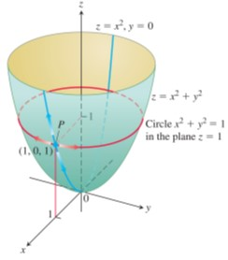
Decide Which Variables Are Dependent and Which Are Independent (6 of 6)
If P is constrained to lie on the paraboloid
the value of the partial
derivative of
with respect to x at P depends on the
direction of motion. (1) As x changes, with y = 0, P moves up or down the
surface on the parabola
in the
x z-plane with
(2) As x changes, with z = 1, P moves
on the circle
z = 1, and
Notes:
A circle for x squared + y squared = 1 is plotted along the plane at z = 1. An upward opening parabola z = x squared, y = 0, has its vertex at the origin. The parabola intersects the circle at P (1, 0, 1).

Slide 37
How to Find Partial Derivative of w With Respect to Partial Derivative of x When the Variables in w = f of Start Expression x, y, and z End Expression Are Constrained by Another Equation (1 of 4)
1. Decide which variables are to be dependent and which are to be independent. (In practice, the decision is based on the physical or theoretical context of our work. In the exercises at the end of this section, we say which variables are which.)
2. Eliminate the other dependent variable(s) in the expression for w.
3. Differentiate as usual.

Slide 38
How to Find Partial Derivative of w With Respect to Partial Derivative of x When the Variables in w = f of Start Expression x, y, and z End Expression Are Constrained by Another Equation (2 of 4)
Example: Find
at the point
and x and y are the independent variables.
Solution: It is not convenient to eliminate z in the expression for w. We therefore differentiate both equations implicitly with respect to x, treating x and y as independent variables and w and z as dependent variables. This gives

Slide 39
How to Find Partial Derivative of w With Respect to Partial Derivative of x When the Variables in w = f of Start Expression x, y, and z End Expression Are Constrained by Another Equation (3 of 4)
Solution (continued):
and
These equations may now be combined to express
in terms of x, y, and z. We solve for
to get

Slide 40
How to Find Partial Derivative of w With Respect to Partial Derivative of x When the Variables in w = f of Start Expression x, y, and z End Expression Are Constrained by Another Equation (4 of 4)
Solution (continued):
and substitute to get
The value of this derivative at
is

Slide 41
Notation (1 of 2)
To show what variables are assumed to be independent in calculating a derivative, we can use the following notation:
with x and y independent
with y, x and t independent

Slide 42
Notation (2 of 2)
Example: Find
if
and
Solution: With x, y, z independent, we have

Slide 43
Arrow Diagrams (1 of 3)
In solving problems like the one in the previous Example, it often helps to start with an arrow diagram that shows how the variables and functions are related. If
and we are asked to find
when x, y, and z are independent,
the appropriate diagram is one like this:

Slide 44
Arrow Diagrams (2 of 3)
To avoid confusion between the independent and intermediate variables with the same symbolic names in the diagram, it is helpful to rename the intermediate variables (so they are seen as functions of the independent variables).
Thus, let
and s = z denote the renamed
intermediate variables. With this notation, the arrow diagram becomes

Slide 45
Arrow Diagrams (3 of 3)
To find
we apply the four-variable form of the
Chain Rule to w, guided by the arrow diagram:

Slide 46

Copyright
This work is protected by United States copyright laws and is provided solely for the use of instructors in teaching their courses and assessing student learning. Dissemination or sale of any part of this work (including on the World Wide Web) will destroy the integrity of the work and is not permitted. The work and materials from it should never be made available to students except by instructors using the accompanying text in their classes. All recipients of this work are expected to abide by these restrictions and to honor the intended pedagogical purposes and the needs of other instructors who rely on these materials.

